Slide 1
St. Xavier’s College
M. Sc. BDA

Slide 2
Two factor independent analysis of variance: Introduction
We perform a two factor ANOVA when we wish to examine the effect of two independent variables on one dependent variable and the assumptions of a parametric test are met.
There are three types of two factor ANOVA and we need to make sure that we select the correct one for our data.
When both the independent variables are independent measures, we perform a two factor independent measures ANOVA.
When both independent variables have repeated measures across the conditions, we undertake a two factor repeated measures ANOVA.
When one independent variable is independent measures and the other repeated measures we perform a two factor mixed design ANOVA.

Slide 3
Two factor independent analysis of variance: Introduction
If we are comparing the effects of gender (boys and girls) and birth position (first born, middle, youngest child) on reading ability in 10 year old children, both variables are independent measures.
The important aspect of the two factor independent measures ANOVA is that we examine the two factor together, so we produce an interaction as well as the main effects of gender and birth position.
If for example, first born boys read better than boys in other birth position. But the youngest girls read better than the other girls than boys, in other found an interaction of the two factors: gender and birth order.

Slide 4
Two factor independent analysis of variance: Assumption
The data is randomly sampled.
The scores are measured on an interval scale and are from normally distributed populations.
The samples in each condition are drawn from populations with equal variances (the homogeneity of variance assumption).

Slide 5
Two factor independent analysis of variance: Example
An expanding company wanted to know how to introduce a new type of machine into the factory. Should it transfer staff working on the old machine to operate if or employ new staff who had not worked on any machine before?
A researcher selected 12 staff who had experience of the old machine and 12 staff who had no such experience. Half the participants from each group were allocated to the new machine and half to the old machine.
The number of errors made by the participants over a set period was measured.

Slide 6
Two factor independent analysis of variance: Example
 | Machine
Experience | Old | New
Newly | 4 | 5
Newly | 5 | 6
Newly | 7 | 5
Newly | 6 | 6
Newly | 8 | 5
Newly | 5 | 6
Experience | 1 | 8
Experience | 2 | 9
Experience | 2 | 8
Experience | 3 | 8
Experience | 2 | 7
Experience | 3 | 9

Slide 7
Data Entry
errors=scan()
4 5 7 6 8 5 1 2 2 3 2 3 5 6 5 6 5 6 8 9 8 8 7 9
person=c(rep(‘newly’,6),rep(‘exp’,6),rep(‘newly’,6),rep(‘exp’,6))
machine=c(rep(‘old’,12),rep(‘new’,12))
ex2=data.frame(errors,person,machine)
ex2
Summary(ex2)

Slide 8
Procedure
ex2.aov=aov(errors~person+machine+person:machine,data=ex2)
(+ this takes into account the variability due to each other separately, : indicates the interaction between these two predictor variables)
model.tables(ex2.aov,type=‘means’)

Slide 9
Two factor independent analysis of variance: Interpretation
No post hoc tests were required as both independent factors only had two levels. For two factor independent measures ANOVAs, where one or both factors have three or more levels.
The novice workers were making almost the same number of errors on the old machine type (5.8333) as on the new machine type (5.500).
The experience workers, however, were making fewer errors on the old machine (2.1667) than on the new machine (8.1667).

Slide 10
Two factor independent analysis of variance: Interpretation
We can see from the Test of Between Subjects Effects table that for our factor ‘experience’ we have not found a significant main effect, F(1, 20) = 1.667, p > 0.05.
We have found a significant main effect for our factor ‘machine’, i. e. whether our participants were using old or new machinery.
F(1, 20) = 53. 519, p < 0.001.
Our results also indicate a significant interaction between our two factors F(1, 20) = 66.852, p < 0.001.

Slide 11
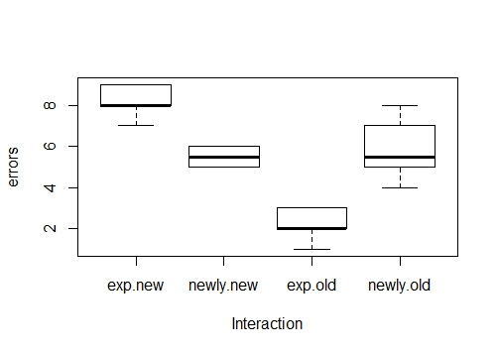
Graphical Presentation
boxplot(errors~person*machine,data=ex2)
title(xlab=‘Intersaction’,ylab=‘Errors’)

Slide 12
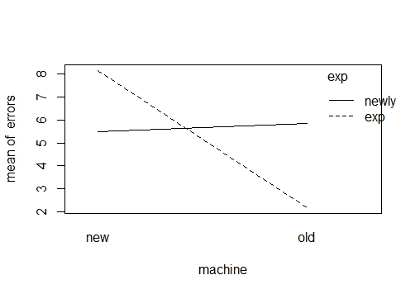
Graphical Presentation
Interaction.plot(person,machine,errors,col=c(‘red’,’blue’)
with(ex2, tapply(errors, machine, sum))

Slide 13
Two factor independent analysis of variance: Interpretation
We can see from the interaction plot that the experienced workers, not surprisingly, made the fewest errors on the old machine, but made the most errors on the new machine.
The novice workers appear to perform with equal accuracy on both machines.

Slide 14
Two factor independent analysis of variance: Example
Assume that you are studying the effects of observing violent acts on subsequent aggressive behavior.
You are interested in the kind of violence observed: a violent cartoon versus a video of real action violence.9
A second factor is the amount of time one is exposed to violence: ten minutes or thirty minutes.
You randomly assign 8 children to each group. After the child watches the violent carton or action video, the child plays a Tetris like computer video game for thirty minutes.
The game provides options for points without interfering with the other player. The program provides 100 opportunities for the player to make an aggressive choice and records the number of times the child choses an aggressive when the game provides the choice.

Slide 15
Two factor repeated measures analysis of variance: Example
 |  | Kind of Violence
 |  | Cartoon | Real Action
Time | 10 minutes | 47 | 52
 |  | 56 | 62
 |  | 48 | 57
 |  | 51 | 49
 |  | 46 | 64
 |  | 44 | 39
 |  | 50 | 50
 |  | 51 | 48
 | 30 minutes | 67 | 81
 |  | 69 | 92
 |  | 65 | 82
 |  | 62 | 92
 |  | 67 | 82
 |  | 69 | 94
 |  | 59 | 86
 |  | 72 | 83

Slide 16
Two way ANOVA example
Plant | Water
 | Low | Medium | High
Vulgaris | 9 | 14 | 28
 | 11 | 17 | 31
 | 6 | 19 | 32
Sativa | 7 | 14 | 44
 | 6 | 17 | 38
 | 5 | 15 | 37

Slide 17
Data entry
height=scan()
9 11 6 14 17 19 28 31 32 7 6 5 14 17 15 44 38 37
plant=factor(c(rep,”vulgaris”,9),(rep”sativa”,9))
water=factor(c(rep,”low”,3),(rep,”med”,3),(rep,”high”,3), (rep,”low”,3),(rep,”med”,3),(rep,”high”,3))
pw=data.frame(height,plant,water)
summary(pw)

Slide 18
Procedure
pw.aov=aov(height~plant+water, data=pw)
pw.aov=aov(height~plant*water,data=pw)
TukeyHSD(pw.aov)
TukeyHSD(pw.aov, which=“water”)
TukeyHSD(pw.aov, which=c(“plant”,”water”)
TukeyHSD(pw.aov, which=“plant:water)
TukeyHSD(pw.aov, which=“plant:water,ordered=TRUE)
TukeyHSD(pw.aov, which=“plant:water”,conf.level=0.99)

Slide 19
Procedure
boxplot(height~plant*water, data=pw, cex.axis=0.9)
(cex makes the axis labels a bit smaller so they fit and display)
title(xlab=“Interaction”,ylab=“Height”)
plot.design(pw)
plot(TukeyHSD(pw.aov))
(not readable)
op =par(mar=c(5,8,4,2))
(set margin bottom, left, top and right)

Slide 20
Procedure
plot(TukeyHSD(pw.aov, ordered=T),cex.axis=0.7,las=1)
(las=0,1,2,3 = labels parallel to the axis, horizontal,perpendicular,vertical)
abline(v=0, lty=2,col=“Red”)
par(op)
model.types(pw.aov,type=“means”,se=T)
model.types(pw.aov,type=“means”,cterms=c(“plant:water”))
pw.mt=model.types(pw.aov,type=“means”,se=T)
names(pw.mt)
names(pw.mt$tables)
pw.mt$tables$”plant:water”

Slide 21
Procedure
attach(pw)
tapply(height,list(plant,water),FUN=mean)
detacth(pw)
interaction.plot(water,plant,height)
interaction.plot(plant,water,height, type=“b”,pch=3:1,lty=3:1,col=c(“Red”,”Green”,Blue”),xlab=“Plant treatement”, ylab=“Mean plant height cm”,main = “Interaction plot”)

